Slide 1
Unlocking Stroke Risk Insights:
A Data-Driven Approach
Leveraging Data for Strategic Health Decisions
Presented by Sheng Miao, March 28, 2025

Slide 2
Agenda
Introduction and Objective
Key Questions Explored
Data Overview
Trends and Correlations Uncovered
Visual Insights
Hypothesis and Recommendations
Conclusion and Next Steps
Notes:
This agenda outlines our structured approach, guiding executives through the motivation, methods, findings, and strategic implications of stroke risk prediction analysis.

Slide 3
Introduction and Objective
Stroke remains a leading cause of disability and mortality globally, costing healthcare systems billions annually.
Objective: Use the Stroke Risk Prediction Dataset to identify actionable patterns and inform strategic health initiatives.
Why it matters to you: Data-driven insights can optimize resource allocation and improve patient outcomes.
Notes:
We begin with the motivation—stroke causes serious harm and expense. Our aim is to discover patterns using data that allow us to detect risk earlier and allocate resources wisely.

Slide 4
Key Questions Explored
Which patient characteristics most strongly correlate with stroke risk?
How do symptoms and demographics interplay?
Can we predict high-risk groups for targeted interventions?
Notes:
These questions form the foundation of our analysis. We want to understand what drives stroke risk and how to predict it with confidence.

Slide 5
Data Overview
Source: Kaggle Stroke Risk Prediction Dataset
~35,000 patient records
Features: Age, Gender, 15 Symptoms, Stroke Risk %
Clean dataset: no missing values
Notes:
This dataset comes from medical literature and expert synthesis. It includes a wide array of symptoms, demographics, and risk estimates. Clean data enabled focused analysis.

Slide 6
Trends Investigated
Age vs Stroke Risk: Sigmoidal trend after 50
Gender-Specific Risk Divergence
Key Symptoms: High BP, chest pain, dizziness
Risk Threshold: ≥50% is 'at risk'
Notes:
We explored four key dimensions, focusing on how stroke risk changes with age, gender, symptom combinations, and specific thresholds that signal urgent attention.

Slide 7
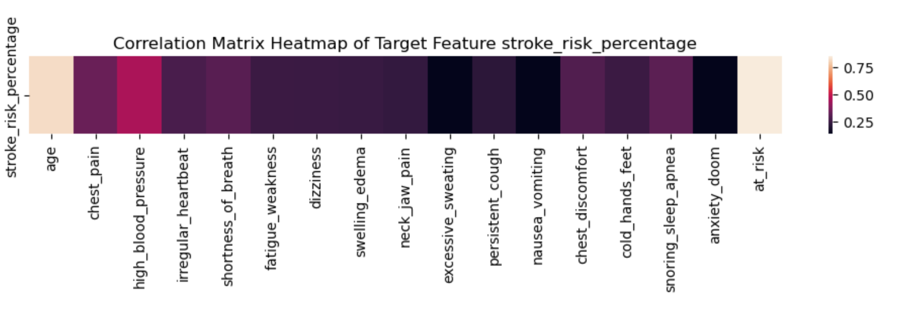
Correlation Analysis and Key Symptoms
Notes:
The strongest correlations point to age and cardiovascular symptoms. These are the variables executives should prioritize in healthcare policy and screenings.

Slide 8
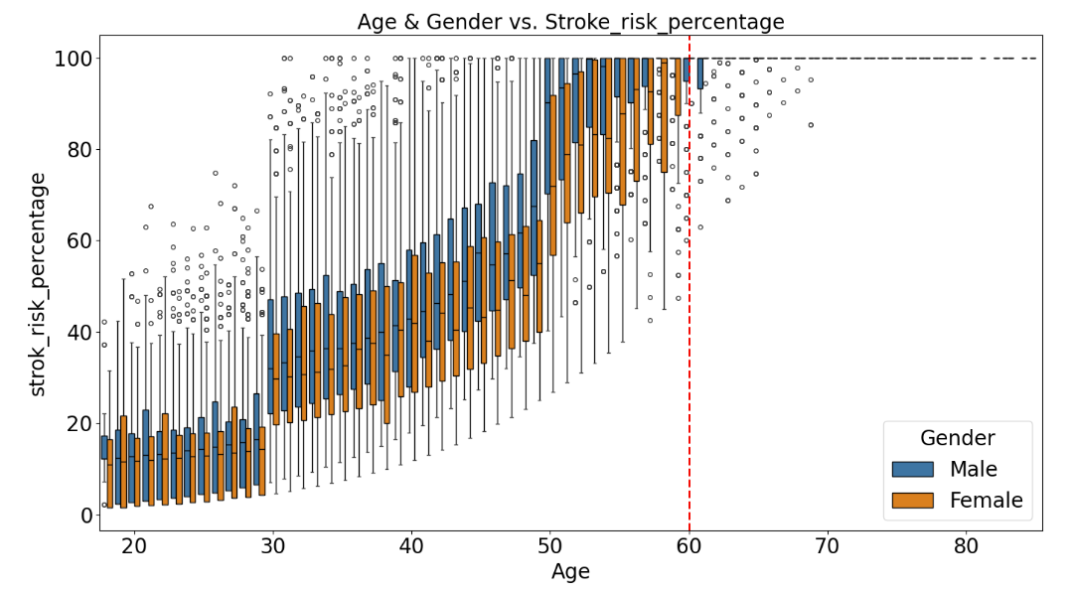
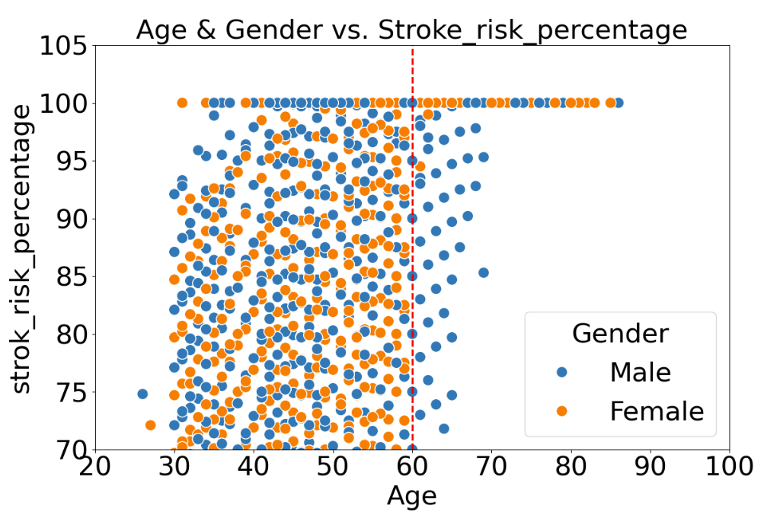
Visual Insight: Age and Gender Impact
Age impact: Stroke risk now follows a sigmoidal curve (sharp increase after age 50),
Gender impact: Males under 60 have 1.5× higher risk, while females over 60 have 1.8× higher risk (post-menopausal hormonal changes).
Notes:
Males under 60 have 1.5x higher risk. Females over 60 show even greater vulnerability, likely tied to hormonal changes post-menopause.

Slide 9
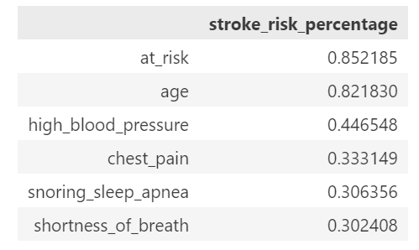
Hypothesis Development
Hypothesis: Patients over 50 with high blood pressure, chest pain and snoring_sleep_apnea are 80% more likely to be at high stroke risk.
Notes:
We hypothesize patients over 50 with high BP and irregular heartbeat are 80% more likely to be high-risk. Next step: test with logistic regression.

Slide 10
Recommendations for Executives
Prioritize screening for patients over 50 with cardiovascular symptoms.
Allocate resources to early intervention programs targeting high blood pressure and other risk symptoms.
Invest in predictive analytics to refine risk thresholds.
Notes:
Focus screening on patients over 50 with cardiovascular symptoms. Invest in predictive modeling to streamline early detection.

Slide 11
Conclusion
Summary: Age and specific symptoms are key drivers of stroke risk, offering clear targets for intervention.
Impact: Strategic focus on high-risk groups can reduce incidence and costs.
Notes:
Age and symptoms offer clear, actionable targets for stroke prevention. Strategic intervention here can reduce costs and save lives.

Slide 12
Next Steps
Build a predictive model for real-time risk assessment
Notes:
1. Launch pilot screening programs. 2. Build predictive models. 3. Expand dataset with longitudinal studies for refinement.

Slide 13
Q&A
Notes:
Thank you for your attention. I'm happy to answer any questions or discuss how we can operationalize these insights in your organization.

